Slide 1

MONTHLY PERFORMANCE REPORT
Melbourne Osteopathy Sports Injury Centre
March + April 2026

Slide 2

01 · OVERVIEW
Executive summary
⚠ MANUAL UPDATE REQUIRED — Auto-draft below from API deltas — review tone and add narrative before sending.
Bookings rebounding into autumn.
Total appointments held: 1,598 this period vs 1,689 for Mar+Apr 2025 (-5.4% YoY). April alone hit 871 bookings — the strongest month in the trailing 12-month window.
New-patient flow steady, traffic flat.
New patients: 95 this period vs 89 prior year (+6.7% YoY). AUS website visitors: 2,579 vs 2,574 last year (+0.2% YoY) — essentially flat. Conversion rate (visitor → new patient) is steady.
Action this period
Confirm Google Ads phone-call recovery, review HotDoc booking conversion, and monitor the rebuilt landing-page copy for click-to-book lift. Cliniqapps figures, phone-call totals and HotDoc bookings still pending — see flagged slides.
MOSIC · Mar + Apr 2026 · 02

Slide 3
02 · SNAPSHOT
Period snapshot — Mar + Apr 2026
Year-on-year comparison vs Mar + Apr 2025
WEBSITE VISITORS (AUS)
APPOINTMENTS HELD
TOTAL NEW PATIENTS
TOTAL NEW PATIENTS - GOOGLE
2,579
1,598
95
170
▲ 0.2% YoY
▼ 5.4% YoY
▲ 6.7% YoY
▲ 6.3% YoY
vs 2,574 prior year
vs 1,689 prior year
vs 89 prior year
vs 160 prior year
MOSIC · Mar + Apr 2026 · 03

Slide 4
03 · CLINIKO
Cliniko — appointments held
Source: Cliniko API. Original deck tracked 'Cliniko booking page confirmations' (GA4 event), which is a subset — this view shows all completed appointments.
MOSIC · Mar + Apr 2026 · 04

Slide 5
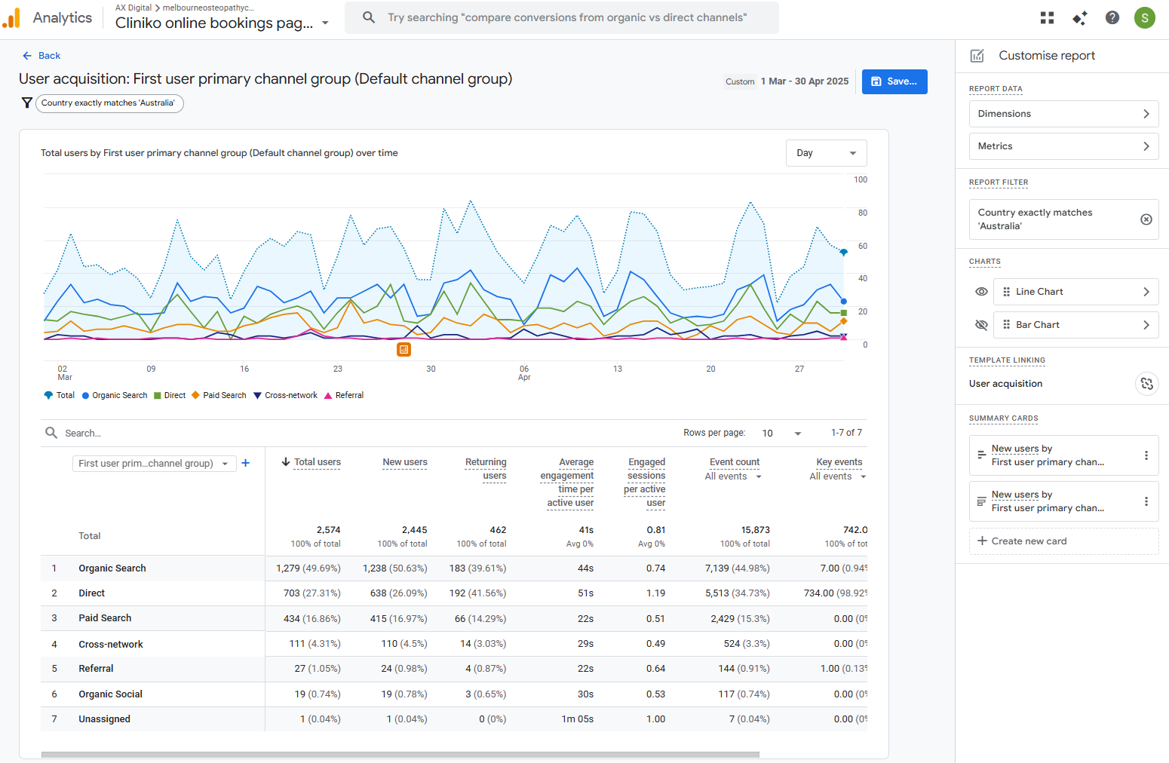
03b · CLINIKO
Entered the Cliniko booking page
⚠ MANUAL UPDATE REQUIRED — GA4 page-view counts for the Cliniko booking page need confirming. GA4 does show /bookings (685 views) and /book-an-appointment-melb-osteo (603 views) for Mar + Apr 2026 combined — copy a 12-month series in if those are the right paths.
-The number of people entered the cliniko page for March + April is 742. This is captured by the key events.
-Ensure to filter that you are only looking at Australia traffic
MOSIC · Mar + Apr 2026 · 05

Slide 6


04 · GOOGLE ADS
Google Ads — phone calls
⚠ MANUAL UPDATE REQUIRED — Google Ads phone_calls metric requires call_view (call tracking) or campaign-level segment that this account doesn't expose. Pull from Google Ads UI manually.
March
April
MOSIC · Mar + Apr 2026 · 06

Slide 7
05 · WEBSITE
Website traffic (AUS only)
Last 12 months — Mar + Apr 2026 highlighted in orange.
MOSIC · Mar + Apr 2026 · 07

Slide 8
06 · CONTENT
Most viewed pages — Mar + Apr 2026
Update to top 20 pages. Make sure it is only Australian traffic
Page | Views | Active users
/ | 1,443 | 976
/bookings | 685 | 378
/blog/training/what-is-the-posterior-chain/ | 684 | 573
/book-an-appointment-melb-osteo/ | 603 | 473
/blog/health-well-being/why-does-my-back-hurt-while-washing-the-dishes/ | 389 | 357
/book-an-appointment-pain-relief/ | 290 | 255
/blog/osteopathy/is-sitting-cross-legged-causing-you-pain/ | 286 | 237
/blog/running/shin-splints-diagnosis-and-rehabilitation/ | 232 | 218
/team/ | 207 | 161
/blog/osteopathy/sore-neck-when-sleeping/ | 199 | 180
Top 10 pages by total views, Mar + Apr 2026. Source: GA4.
MOSIC · Mar + Apr 2026 · 08

Slide 9
07 · NEW BOOKINGS
Total new patients
ⓘ API SUBSTITUTION — Original deck split this into 'New patients from Google' vs 'Total'. The Google-attribution split needs Google Ads conversion → Cliniko patient matching, which isn't currently wired up. Total shown here.
In the bar, make it show the amount that is coming from google ads/ website
Source: Cliniko API (patients created in window).
MOSIC · Mar + Apr 2026 · 09

Slide 10
07b · LOCATIONS
Appointments by location
ⓘ API SUBSTITUTION — Showing all appointments per location (Cliniko). Original deck used 'new patients per location' — that requires manual cross-ref of new patient → first appointment business and isn't reliable via API.
In the bar, make it show the amount that is coming from google ads/ website
MOSIC · Mar + Apr 2026 · 10

Slide 11
08 · AUTOMATIONS
Cliniqapps email automations
DNA Rebooker All Patients
Month | Patients Booked | Appointments Booked
April | 0 | 0
March | 6 | 25
February | 3 | 4
January | 6 | 10
Reactivation 6 – 12 Months
Month | Patients Booked | Appointments Booked
April | 4 | 7
March | 8 | 13
February | 3 | 4
January | 3 | 3
Cancellation Rebooker All Patient
Month | Patients Booked | Appointments Booked
April | 15 | 29
March | 11 | 28
February | 10 | 20
January | 12 | 24
Reactivation 12 Months +
Month | Patients Booked | Appointments Booked
April | 2 | 3
March | 1 | 2
February | 2 | 4
January | 2 | 6
Reactivation 3 – 6 Months
Month | Patients Booked | Appointments Booked
April | 7 | 8
March | 12 | 26
February | 5 | 6
January | 10 | 14
MOSIC · Mar + Apr 2026 · 11

Slide 12
09 · BROADCAST
Cliniqapps Newsletter Stats
Month | With or without appointments | Number of sends | Open Rate | Click Rate
April | With | 4561 | 32.56% | 0.55%
 | Without | 2989 | 18.87% | 0.54%
March | With | 4559 | 33.58% | 0.83%
 | Without | 3003 | 19.41% | 0.67%
February | N/A | - | - | -
January | N/A | - | - | -
December (End of year email) | With | 4475 | 33.97% | 0.83%
 | Without | 3004 | 21.47% | 1.53%
November | With | - | - | -
 | Without | - | - | -
October | With | 4456 | 36.94% | 0.79%
 | Without | 3023 | 23.55% | 0.63%
September | With | 4467 | 34.21% | 0.76%
 | Without | 3044 | 22.37% | 0.66%
August | With | 4452 | 44.41% | 0.58%
 | Without | 3067 | 27.19% | 0.39%
July | With | 4435 | 36.78% | 0.72%
 | Without | 3084 | 23.09% | 0.49%
June | With | - | - | -
 | Without | - | - | -
May | With | 4398 | 34.61% | 0.89%
 | Without | 3089 | 22.05% | 0.65%
April | With | 4411 | 40.81% | 0.79%
 | Without | 3107 | 24.72% | 0.39%
March | With | 4404 | 33.22% | 0.70%
MOSIC · Mar + Apr 2026 · 12

Slide 13
10 · ACTIONED
Actioned items this period
Website Development
Other
Uploaded – Managing Stress and Its Physical Impact on your body
Uploaded – Marathon Training Without Injury: Your complete Prevention Guide
Uploaded – Movement for Busy Lifestyles: Staying Active with Limited Time
Uploaded – Cardio vs Strength Training: Finding the Right Balance for Your Body
Uploaded – Running with a Cause: Train Smar for Melbourne’s Charity Runs
Added Rachel Limanou to the website
Updated Mo’s profile
Updated running injury webpage
Website team member order
Provided Q2 Marketing Calendar
Looked into the Moomba Magic
Looked into Linkedin Profile for MOSIC
Drafted the Internal database promotion
Revised the Google Ads
MOSIC · Mar + Apr 2026 · 13

Slide 14
10 · ACTIONED
Tasks for next two months
Website Development
Ongoing blog posting
Audit the 404 error websites
New scoliosis web page
TAC webpage
Other
Ongoing social media posting
Ongoing digital marketing support
Ongoing Google ads optimisation
MOSIC · Mar + Apr 2026 · 13

Slide 15
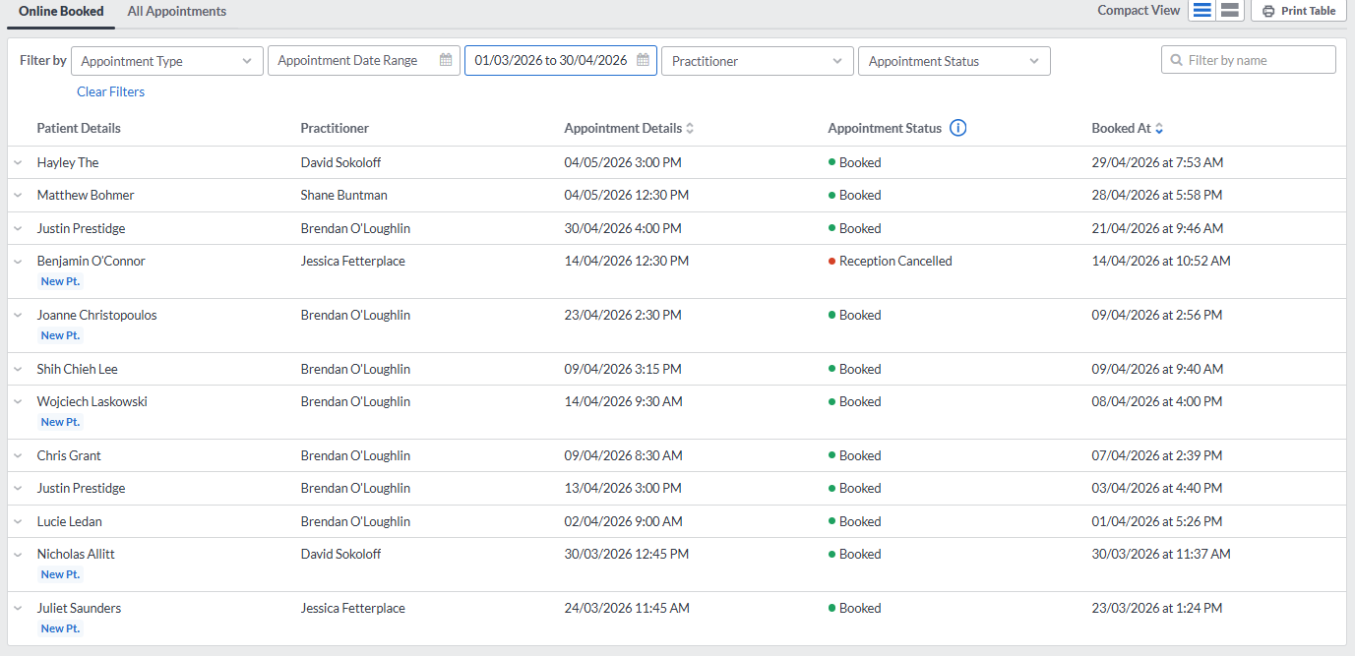
11 · APPENDIX
HotDoc bookings
⚠ MANUAL UPDATE REQUIRED — HotDoc does not expose monthly booking totals via API. Pull from the HotDoc dashboard manually (count bookings for Mar + Apr 2026, per location).
MOSIC · Mar + Apr 2026 · 14

